Slide 1
ENEL 895AK
ECC Based Key Management Schemes

Slide 2
Routing-Driven ECC Key Management
[1] suggests a routing-driven key management system based on ECC certificates.
The system depends on the existence of many restricted-function devices (L nodes) and a few higher-function devices (H nodes). The H nodes are used as cluster-heads in the network.
During network setup, each node generates a key pair and shares the public key with its cluster head.
Finally, the cluster head generates signed certificates for each node and acts as a Certificate Authority during transmissions.
X. Du, M. Guizani, Y. Xiao and H. Chen, "Transactions papers a routing-driven Elliptic Curve Cryptography based key management scheme for Heterogeneous Sensor Networks," in IEEE Transactions on Wireless Communications, vol. 8, no. 3, pp. 1223-1229, March 2009.

Slide 3
Routing-Driven ECC Key Management
Using this system, if a node fails, other nodes only need to examine their routing table and collect the proper certificates from their cluster head.
If a cluster head fails, the network needs to initiate a setup event with another cluster head to build new clusters
The system can be used with pre-loaded ECC pairs to save energy or can be used with dynamically generated keys.
X. Du, M. Guizani, Y. Xiao and H. Chen, "Transactions papers a routing-driven Elliptic Curve Cryptography based key management scheme for Heterogeneous Sensor Networks," in IEEE Transactions on Wireless Communications, vol. 8, no. 3, pp. 1223-1229, March 2009.

Slide 4
Hierarchical Self-Certified Management
[2] proposes a cluster based system for establishing secure sessions between cluster heads and members with no prior shared knowledge
This system was proposed for medical sensor network applications
This system depends on a tree-based hierarchy system and is based on setting up Shared Session Keys (SSK) between cluster heads and members
The system has a root level Secure Access Point (SAP) which acts as the WSN gateway. The root SAP manages other cluster head SAP’s in the backbone cluster. These cluster head SAP’s in turn manage nodes in their cluster.
C. H. Tseng, S. Wang and W. Tsaur, "Hierarchical and Dynamic Elliptic Curve Cryptosystem Based Self-Certified Public Key Scheme for Medical Data Protection," in IEEE Transactions on Reliability, vol. 64, no. 3, pp. 1078-1085, Sept. 2015.

Slide 5
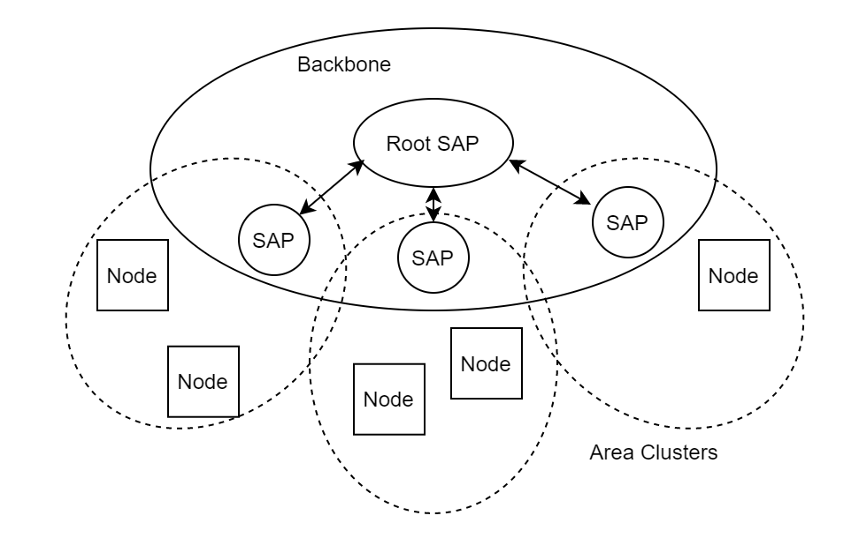
Architecture of the System
The Root SAP manages all cluster heads in the Backbone Cluster
Each cluster head SAP is responsible for an area cluster
The SAP’s drive session creation and management
Each SAP has a pre-established SSK with the Root
Each Node dynamically creates a new SSK with their SAP when needed
C. H. Tseng, S. Wang and W. Tsaur, "Hierarchical and Dynamic Elliptic Curve Cryptosystem Based Self-Certified Public Key Scheme for Medical Data Protection," in IEEE Transactions on Reliability, vol. 64, no. 3, pp. 1078-1085, Sept. 2015.

Slide 6
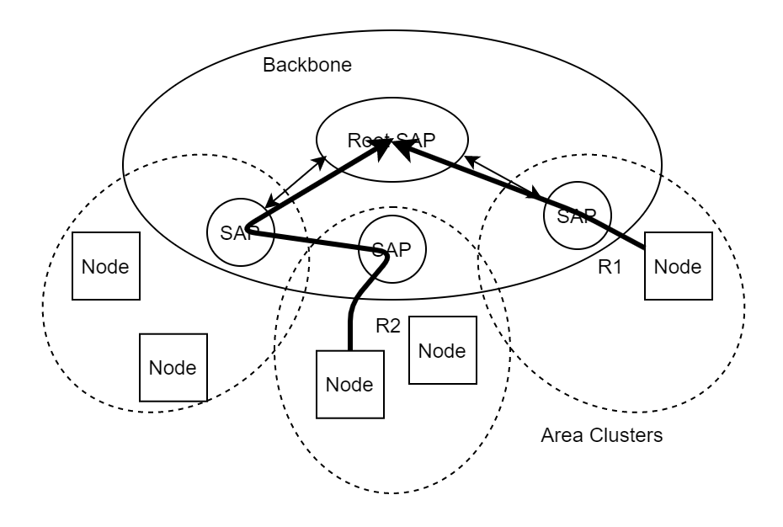
Routing Example 1
R1 route sets up a dynamic SSK between the node and the SAP
This SSK is used to encrypt the message between SAP and Node
The Root SAP and SAP have a pre-established SSK that is used for the final transmission
C. H. Tseng, S. Wang and W. Tsaur, "Hierarchical and Dynamic Elliptic Curve Cryptosystem Based Self-Certified Public Key Scheme for Medical Data Protection," in IEEE Transactions on Reliability, vol. 64, no. 3, pp. 1078-1085, Sept. 2015.

Slide 7
Routing Example 2
R2 route sets up a dynamic SSK between the node and the SAP1
This SSK is used to encrypt the message between SAP1 and Node
The Root SAP and SAP1 have a pre-established SSK that is used for the final transmission
This SSK is used to encrypt the message, and then SAP2 forwards the message to the Root SAP
C. H. Tseng, S. Wang and W. Tsaur, "Hierarchical and Dynamic Elliptic Curve Cryptosystem Based Self-Certified Public Key Scheme for Medical Data Protection," in IEEE Transactions on Reliability, vol. 64, no. 3, pp. 1078-1085, Sept. 2015.

Slide 8
Network Setup
When the network is first setup, each SAP in the backbone network registers with the root SAP and generates an SSK with the root SAP.
These SSK’s are persistent and are used across several messages within the backbone cluster
After this setup phase, the SAP’s look for nodes within their cluster, each cluster head (CH) is made aware of a node (CM) when the node registers itself.
This registration phase consists of the CM sharing it’s public key with the CH and the CH storing the key in it’s cluster key database

Slide 9
Node Registration
When Nodes want to register as a CM in an area cluster, the node takes the following steps:
When a node registers, it sends the nearest CH a Register Request packet (RREQ) that includes the ID of the node ID_{CM} and a request token RT_{CM} that is built using the nodes master public key MK_{CM}
The CH receives the RREQ and uses the node ID and request token to recover the CM public key PK_{CM.} The CH then stores the public key for that node.
The CH crafts a Register Response packet (RREP) containing the CM public key PK_{CM} and a witness token WT_{CH} and sends it to the CM
Finally, the CM uses the witness token and the public key to derive a private key SK_{CM}

Slide 10
SSK Generation
When a node (CM) needs to transmit to the gateway, steps required to setup an SSK between CM and Cluster Head (CH) are:
CM generates a Session Request (SREQ) containing a time-based token TT_{CM} and the node id ID_{CM} transmits it to the CH
The CH receives the SREQ and generates a Session Response containing the TT_{CH,} ID_{CH,} and the public key PK_{CH.} The CH also performs a lookup of the CM’s public key.
The CH now has TT_{CM,} ID_{CM,} and PK_{CM} and the CM now has TT_{CH,} ID_{CH,} and PK_{CH}
Using this shared information they are able to derive a Shared Session Key to encrypt and transmit the message
C. H. Tseng, S. Wang and W. Tsaur, "Hierarchical and Dynamic Elliptic Curve Cryptosystem Based Self-Certified Public Key Scheme for Medical Data Protection," in IEEE Transactions on Reliability, vol. 64, no. 3, pp. 1078-1085, Sept. 2015.

Slide 11
Limitations of Proposal
Some limitations exist in this system, such as:
Due to the fact that each CH need to store a database of its CM’s public keys, the CH nodes need to be a higher functioning node. They will require more storage to manage the database.
In addition to this, each CH is a bottleneck for it’s area cluster and can possibly be a routing path for the other SAP’s in the backbone cluster. This means that the CH nodes need a larger energy capacity in order to handle the additional traffic.
This paper also doesn’t specify how nodes generate the master key pair or if there are any provisions to regenerate the pair. An assumption can be made that in order to regenerate the master the whole node registration process needs to be performed

Slide 12
Next Week
Dive into derivation of key pair and how the nodes master keys are used to derive the public/private keys
Dive into derivation of Shared Session Key used to secure individual communication sessions

Slide 13
References
X. Du, M. Guizani, Y. Xiao and H. Chen, "Transactions papers a routing-driven Elliptic Curve Cryptography based key management scheme for Heterogeneous Sensor Networks," in IEEE Transactions on Wireless Communications, vol. 8, no. 3, pp. 1223-1229, March 2009.
C. H. Tseng, S. Wang and W. Tsaur, "Hierarchical and Dynamic Elliptic Curve Cryptosystem Based Self-Certified Public Key Scheme for Medical Data Protection," in IEEE Transactions on Reliability, vol. 64, no. 3, pp. 1078-1085, Sept. 2015.

